Slide 1
Ninad Khasale J041 Shreyash Nadgouda J046
Personalized Image Caption Generation

Slide 2
Introduction
Image Caption Generation using the Flickr Dataset is a project aimed at automatically generating descriptive captions for images. This project combines the fields of computer vision and natural language processing(NLP) to enable machines to understand and describe the content of images in natural language.
The Flickr dataset is widely used in the field of computer vision and machine learning for tasks such as image classification, object detection, and image captioning. It consists of a large collection of images with associated captions provided by users. The diversity and size of the dataset make it suitable for training machine learning models for image caption generation.

Slide 3
Importance of Image Caption Generation
Image caption generation holds immense importance in various domains including:
Accessibility: Providing visually impaired individuals with textual descriptions of images enhances their accessibility to visual content on the internet.
Content Understanding: Image captions help in better understanding the context and content of images, aiding in tasks such as image search, recommendation systems, and content summarization.
Social Media: Generating captions for images posted on social media platforms can improve engagement and user experience by providing additional context to the images.

Slide 4
ML models
In this project, two key machine learning models are implemented:
VGG16 for Feature Extraction: VGG16 is a convolutional neural network (CNN) architecture used for feature extraction from images.
LSTM-based Caption Generation Model: Long Short-Term Memory (LSTM) is a type of recurrent neural network (RNN) used for generating descriptive captions for images based on their features.
Let us explore and understand the use and application of each of these models in further depth

Slide 5
VGG16
Description: VGG16 is a deep convolutional neural network architecture proposed by the Visual Geometry Group (VGG) at the University of Oxford. It consists of 16 layers, including convolutional layers, max-pooling layers, and fully connected layers.
Feature Extraction: In this project, the VGG16 model is utilized to extract high-level features from images. These features capture the visual information present in the images, which are then used as input to the caption generation model.
Math and Logic: The VGG16 model applies a series of convolutional and pooling operations to the input image, resulting in feature maps that represent different aspects of the image. These feature maps are then flattened and passed through fully connected layers to generate a feature vector that encodes the visual content of the image.
Accuracy and Usage: VGG16 is pre-trained on large-scale image classification tasks such as ImageNet, making it capable of extracting meaningful and discriminative features from images. The accuracy of feature extraction using VGG16 is high, contributing to the overall performance of the caption generation model.

Slide 6
LSTM
Description: LSTM is a type of recurrent neural network (RNN) architecture designed to address the vanishing gradient problem in traditional RNNs. It is capable of learning long-term dependencies and sequential patterns in data.
Caption Generation: The LSTM-based model is trained to generate descriptive captions for images based on their extracted features. It takes the image features as input and generates a sequence of words that form the caption.
Math and Logic: LSTM consists of memory cells that maintain a state over time, allowing them to retain information about previous inputs. This enables LSTM to capture the sequential structure of natural language data and generate coherent captions.
Accuracy and Usage: LSTM-based caption generation models have demonstrated impressive performance in generating accurate and contextually relevant captions for images. By leveraging the sequential nature of language, LSTM effectively captures the relationships between words in the generated captions, resulting in fluent and informative descriptions.

Slide 7
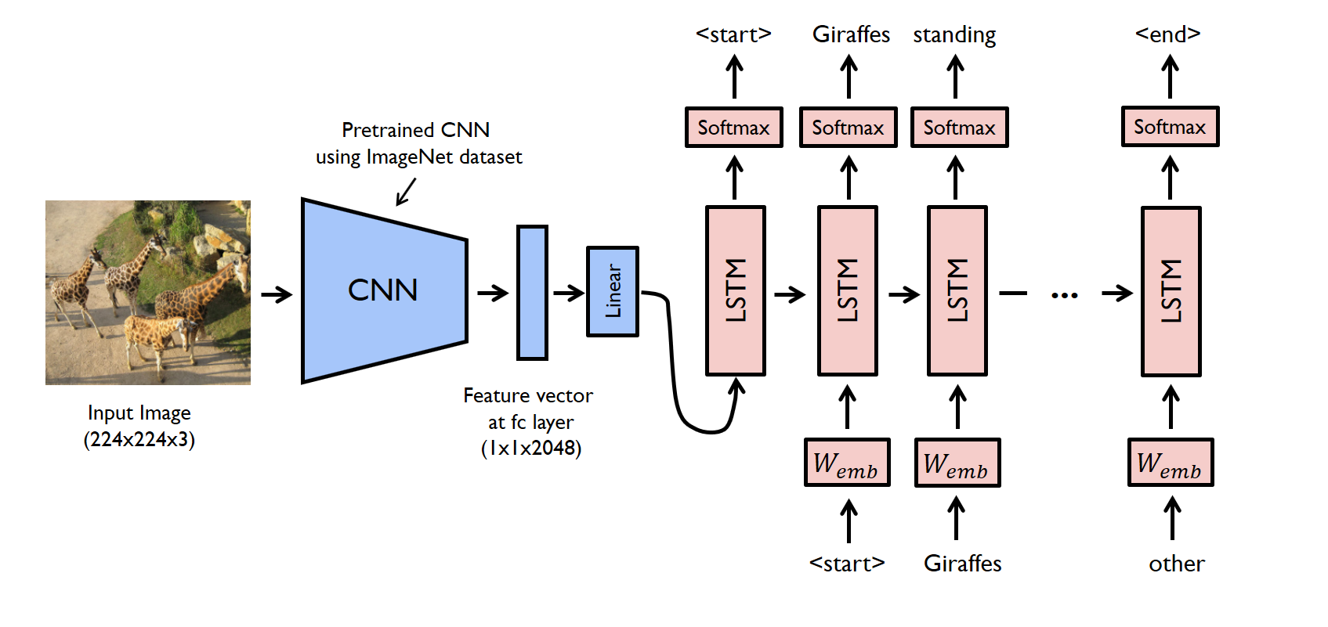

Slide 8
How does it work?
Image Preprocessing Steps: Before feeding images into the VGG16 model, preprocessing ensures compatibility and optimal performance. This involves resizing images to a fixed size (e.g., 224x224 pixels) and normalizing pixel values to the expected range (typically between -1 and 1 or 0 and 1). These steps standardize input images, improving efficiency of feature extraction.
Text Data Preprocessing: Captions associated with images undergo cleaning and preprocessing to ensure consistency and remove noise. Text preprocessing includes converting text to lowercase, removing punctuation and special characters, and filtering out irrelevant information. Tokenization with the Tokenizer class from Keras splits text into tokens, assigning unique integer IDs to each word. This creates a vocabulary mapping words to token IDs, preparing the text data for input into the caption generation model.

Slide 9
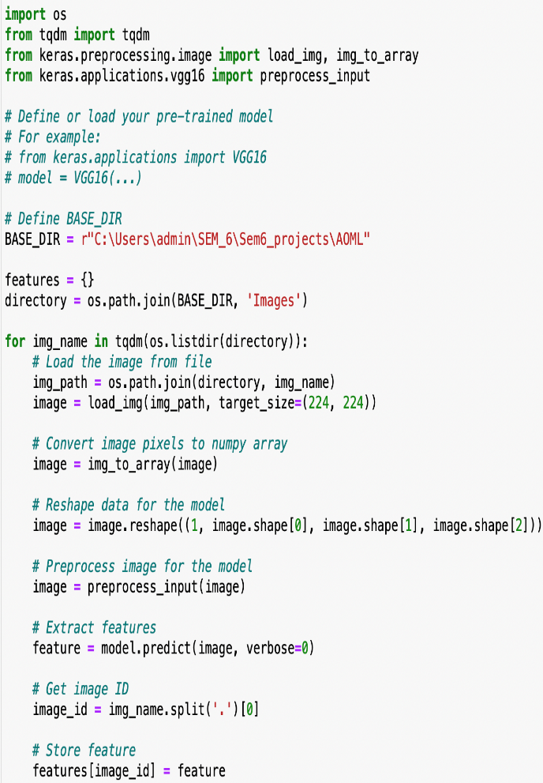
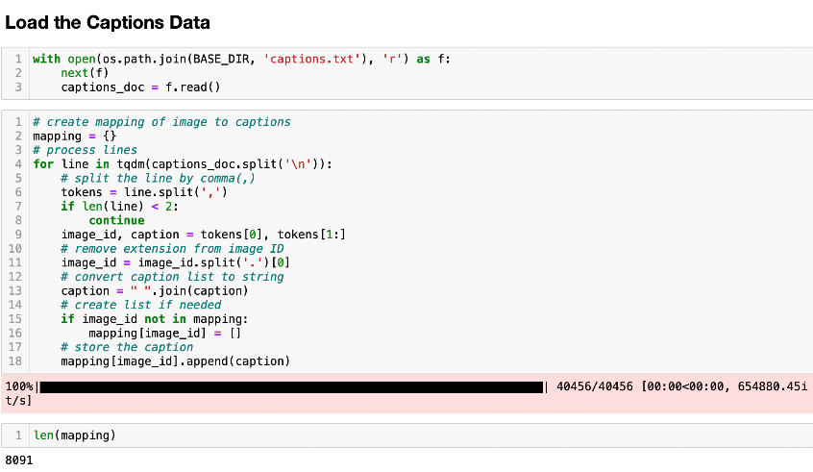
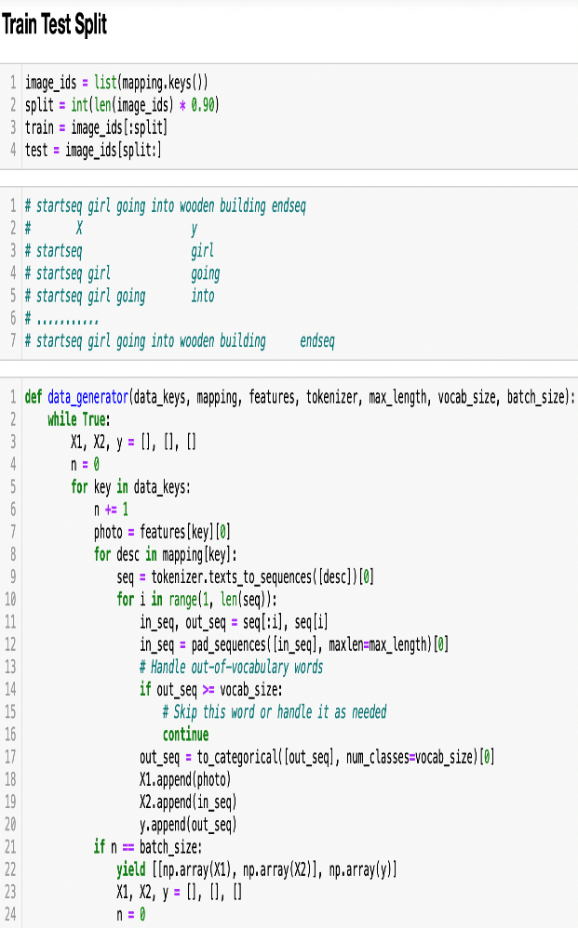
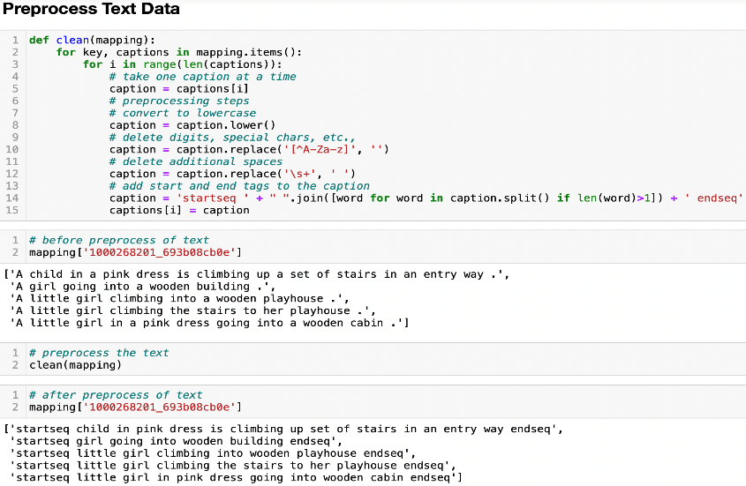
How does it work?

Slide 10
Model Training:
To efficiently train the caption generation model, a data generator function generates batches of training data on-the-fly, iterating over the training data in batches rather than loading the entire dataset into memory. This conserves memory and seamlessly integrates with the training loop.
The caption generation model is trained iteratively over multiple epochs, with each epoch consisting of several training iterations. During training, the model learns to predict the next word in the caption sequence based on the input image features and previously generated words. Optimization algorithms such as Adam optimizer are used to adjust model parameters (weights and biases) and minimize a loss function.
The loss function measures the discrepancy between predicted and ground truth captions. Commonly used loss functions for sequence prediction tasks include categorical cross-entropy, which computes the cross-entropy loss between the predicted probability distribution and the true distribution of words. Adam optimizer, known for its adaptive learning rate capabilities and efficient convergence properties, is employed to minimize the loss function and update model parameters using gradient descent.

Slide 11
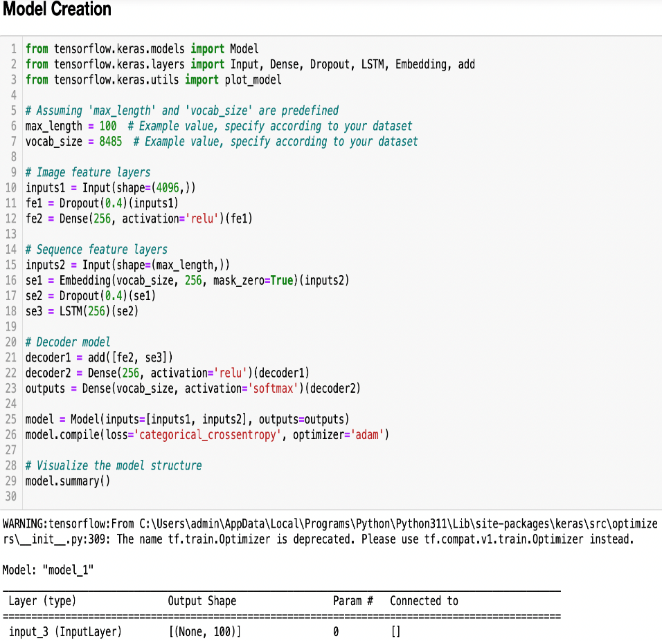
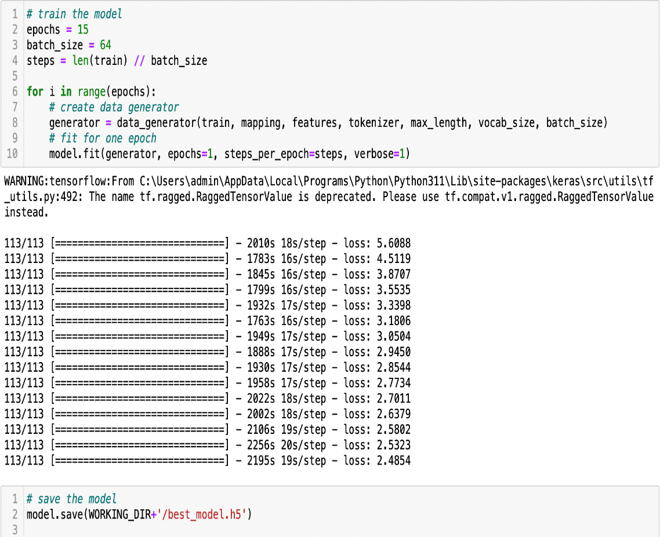
Model Training:

Slide 12
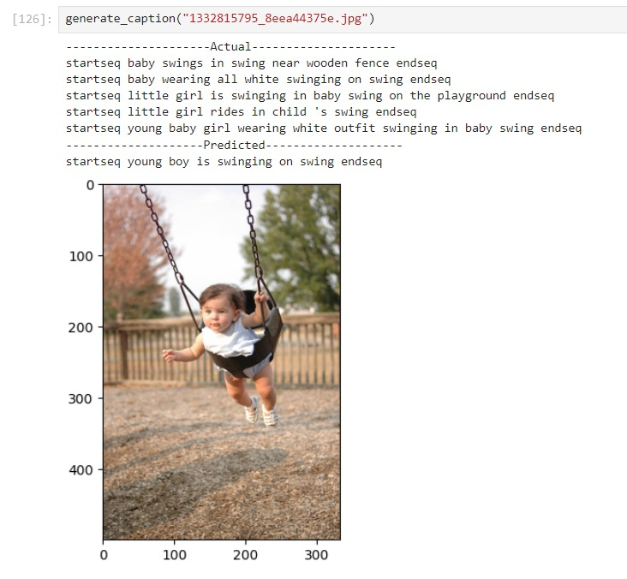
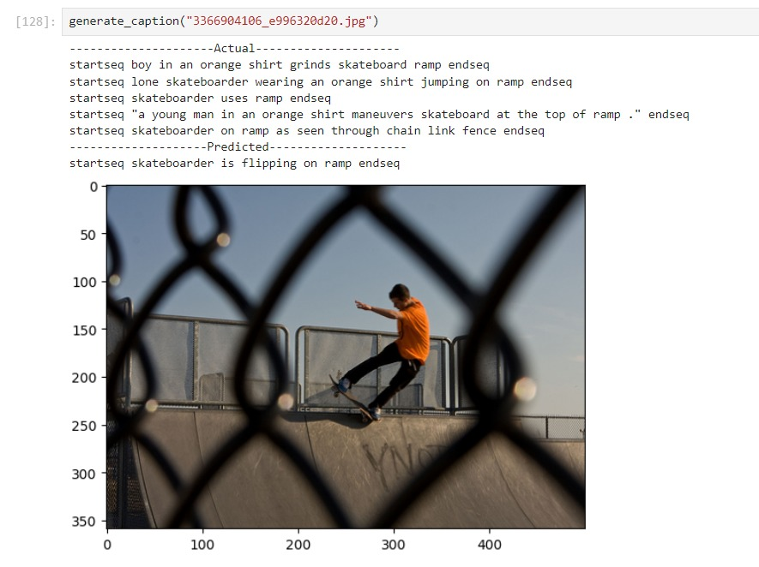
Output

Slide 13
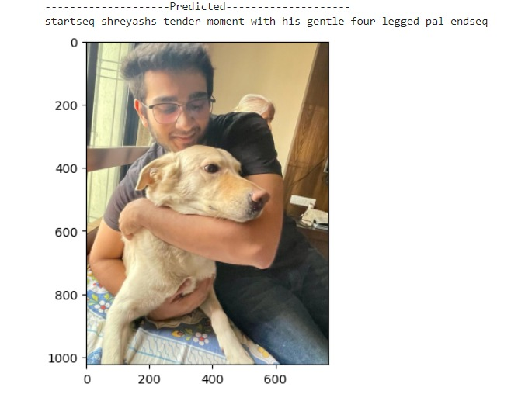
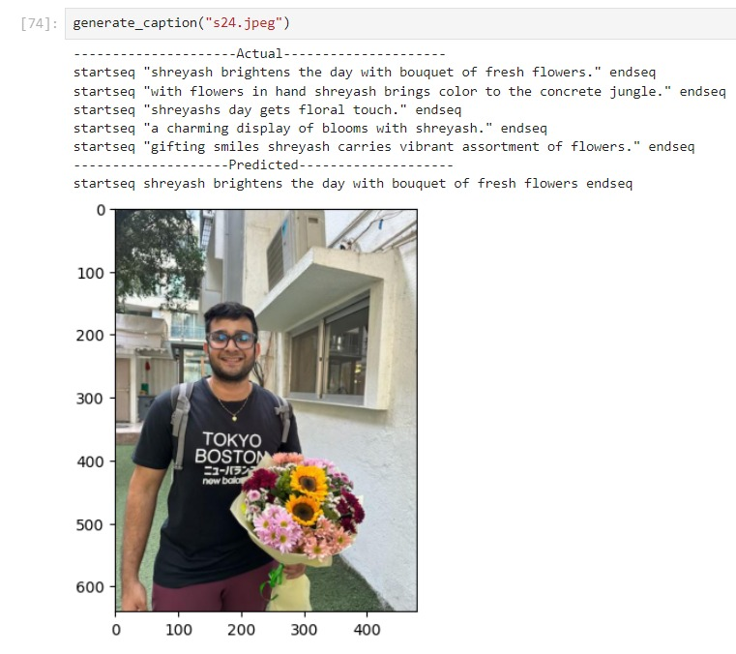
Our own Personal touch!

Slide 14
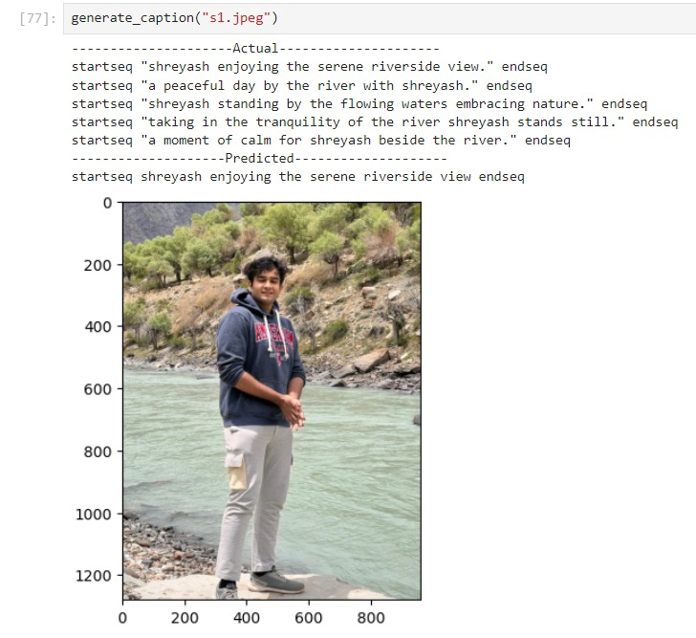
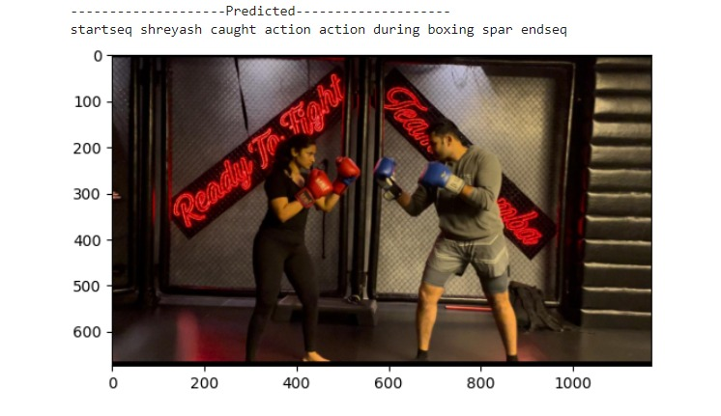
Our own Personal touch!

Slide 15
Thank You!
Ninad Khasale J041 Shreyash Nadgouda J046

